Slide 1
Sentimental Analysis for ChatGPT App Review
Presenters Names: Madhav Adhikari
Sai Neeraj Chandragiri
Nirupavardhan Lingareddygari
Course Name: CMPS-5443-201 AdvTopCS:NaturalLangProc

Slide 2
Introduction
Purpose of Study and Motivation:
Analyzing sentiment in app reviews to understand user feedback and improve the app.
Research Question:
How can sentiment analysis help in understanding user sentiments towards the ChatGPT app?
What are the common words used in reviews for ChatGPT?
Which words are most commonly associated with positive sentiments, and which are associated with negative sentiments?

Slide 3
Methodology
Data Set Used: Web Scraping of reviews from App store for ChatGpt App
Library Used: VADER, NLTK, Matplotlib
Accuracy Verification: manually cross-check review, testing on a small separate dataset, checking most positive and negative words
Rationale for Choices: Initially tried to access Reddit data but faced restrictions for non-premier members. We opted to analyze iOS app store reviews instead. Also, Vader lib is suitable for social media post analysis.

Slide 4
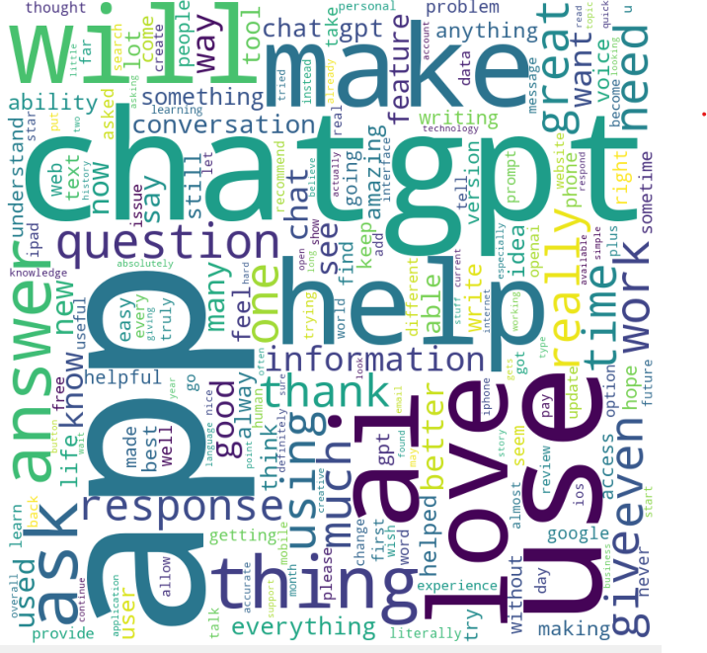
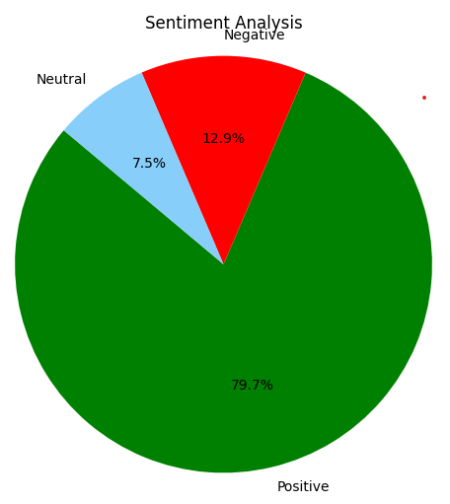
Results
Found out what exactly discussed in the review using world cloud : like question , answer, information, issue, better etc.
Resulted in 79.7% positive sentiment, 7.5% neutral sentiment, and 12.9% negative sentiment, as shown in the pie chart below

Slide 5
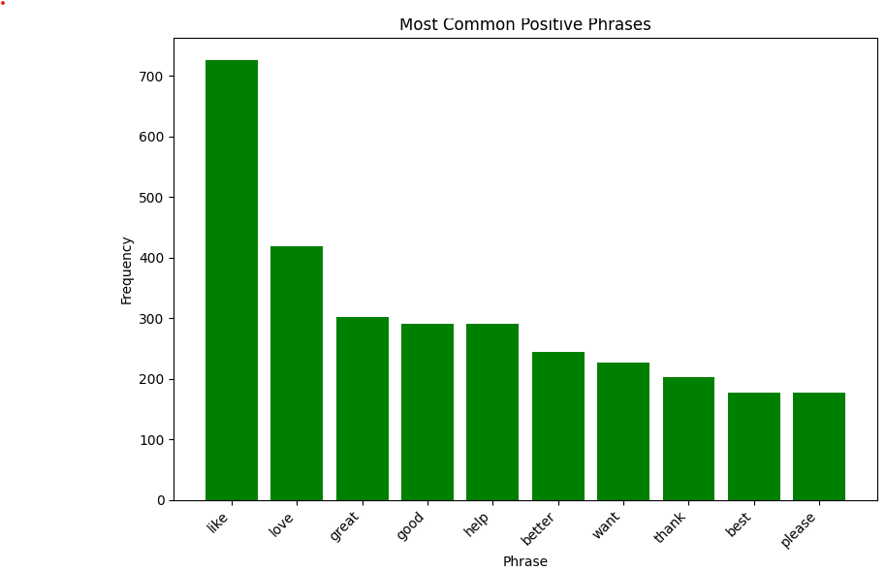
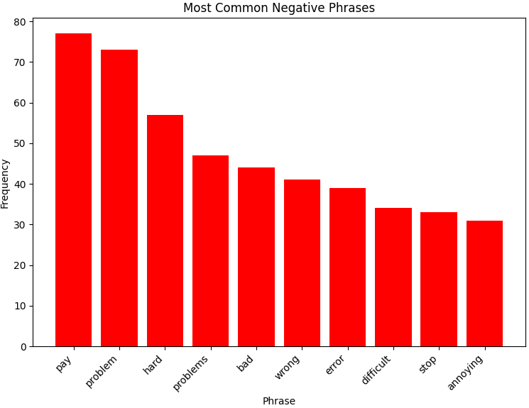
Results
In positive reviews, users frequently used words such as "love," "like," "good," and "better." On the other hand, negative reviews often included words like "pay," "problem," "hard," "bad," and "error."
After the overall analysis, it is evident that users are generally positive towards ChatGPT. However, there are concerns about the paid subscription model

Slide 6
Reflection
Personal Thoughts: We found the project on sentimental analysis for ChatGPT app reviews to be insightful and challenging. It was interesting to see how sentiment analysis can reveal user sentiments and provide valuable insights for improving the app.
Expectations vs. Reality: Initially, we expected the sentiment analysis to show a mix of positive and negative sentiments. However, we was pleasantly surprised to find that the overall sentiment towards ChatGPT was overwhelmingly positive. One challenge we faced was obtaining a suitable dataset, but this was overcome by scraping data from the App Store. Overall, the project exceeded my expectations and provided valuable insights into user sentiments.

Slide 7
References
[1] https://github.com/cjhutto/vaderSentiment
[2] https://www.nltk.org/
[3] https://matplotlib.org/
[4] https://apps.apple.com/us/app/chatgpt/id6448311069

